Slide 1

KCS056 APPLICATION OF
SOFT COMPUTING
UNIT-2
Prepared By- MR. Ashish Tiwari
ASSISTANT PROFESSOR
DEPARTMENT OF COMPUTER SCIENCE ENGINEERING
UNITED COLLEGE OF ENGG. & RESEARCH, PRAYAGRAJ

Slide 2
Unit -2
Neural Networks-II (Back Propagation Network
Back-Propagation Network, topics : Background, what is back-prop network ? learning AND function, simple learning machines – Error measure, perceptron model Perceptron learning rule, Hidden Layer, Back-Propagation Learning : learning by example, single layer artificial neural network multi-layer feed- forward back-propagation network, computation in input, hidden and output layers, error calculation. Back-propagation algorithm for training network - basic loop structure, step-by-step procedure, numerical example. factors affecting back propagation training, applications.

Slide 3
LECTURE - 5

Slide 4
TOPICS TO BE COVERED TODAY
What Are Neural Network Layers?
What Is An Input Layer?
How Many Neurons In Input Layer?
What Is An Output Layer?
What Is A Hidden Layer?
What are the Learning Rules in Neural Network?

Slide 5
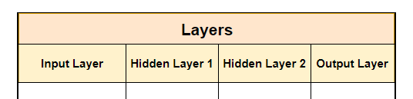
What Are Neural Network Layers?
A layer groups a number of neurons together. It is used for holding a collection of neurons.
The neurons, within each of the layer of a neural network, perform the same function.
They simply calculate the weighted sum of inputs and weights, add the bias and execute an activation function.

Slide 6
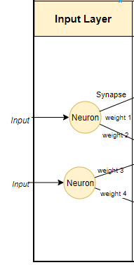
What Is An Input Layer?
The input layer is responsible for receiving the inputs. These inputs can be loaded from an external source such as a web service or a csv (comma-separated values) file.
A CSV is a comma-separated values file, which allows data to be saved in a tabular format.
There must always be one input layer in a neural network. The input layer takes in the inputs, performs the calculations via its neurons and then the output is transmitted onto the subsequent layers.
Input layer takes in the inputs. Output layer produces the final results.

Slide 7

How Many Neurons In Input Layer?
The number of neurons in an input layer is dependent on the shape of your training data.
The training data is an initial set of data used to help a program understand how to apply technologies like neural networks to learn and produce sophisticated results.
The model is initially fit on a training dataset, which is a set of examples used to fit the parameters (e.g. weights of connections between neurons in artificial neural networks) of the model.
One additional node is to capture the bias term.

Slide 8
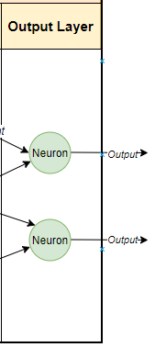
What Is An Output Layer?
The output layer is responsible for producing the final result. There must always be one output layer in a neural network.
The output layer takes in the inputs which are passed in from the layers before it, performs the calculations via its neurons and then the output is computed.
In a complex neural network with multiple hidden layers, the output layer receives inputs from the previous hidden layer.

Slide 9
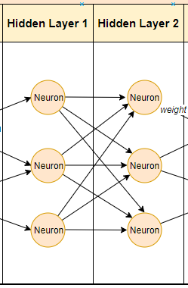
What Is A Hidden Layer?
The introduction of hidden layers make neural networks superior to most of the machine learning algorithms.
Hidden layers reside in-between input and output layers and this is the primary reason why they are referred to as hidden.
The word “hidden” implies that they are not visible to the external systems and are “private” to the neural network.
There could be zero or more hidden layers in a neural network.
One hidden layer is sufficient for the large majority of problems.
The larger the number of hidden layers in a neural network, the longer it will take for the neural network to produce the output and the more complex problems the neural network can solve.
The neurons simply calculate the weighted sum of inputs and weights, add the bias and execute an activation function.

Slide 10

How Many Neurons In Hidden Layer?
Experiments have shown us that the optimum number of neurons in a hidden layer can be determined by:
The factor is used to prevent over-fitting and it is a number between 1–10.

Slide 11
What Is Learning in ANN?
Basically, learning means to do and adapt the change in itself as and when there is a change in environment. ANN is a complex system or more precisely we can say that it is a complex adaptive system, which can change its internal structure based on the information passing through it.
Why Is It important?
Being a complex adaptive system, learning in ANN implies that a processing unit is capable of changing its input/output behavior due to the change in environment. The importance of learning in ANN increases because of the fixed activation function as well as the input/output vector, when a particular network is constructed. Now to change the input/output behavior, we need to adjust the weights.
During ANN learning, to change the input/output behavior, we need to adjust the weights. Hence, a method is required with the help of which the weights can be modified.

Slide 12
What are the Learning Rules in Neural Network?
Learning rule or Learning process is a method or a mathematical logic. It improves the Artificial Neural Network’s performance and applies this rule over the network. Basically, learning means to do and adapt the change in itself as and when there is a change in environment. ANN is a complex system or more precisely we can say that it is a complex adaptive system, which can change its internal structure based on the information passing through it.
Thus learning rules updates the weights and bias levels of a network when a network simulates in a specific data environment.
Applying learning rule is an iterative process. It helps a neural network to learn from the existing conditions and improve its performance.
Let us see different learning rules in the Neural network:
Hebbian learning rule – It identifies, how to modify the weights of nodes of a network.
Perceptron learning rule – Network starts its learning by assigning a random value to each weight.
Delta learning rule – Modification in sympatric weight of a node is equal to the multiplication of error and the input.
Correlation learning rule – The correlation rule is the supervised learning.
Outstar learning rule – We can use it when it assumes that nodes or neurons in a network arranged in a layer.

Slide 13
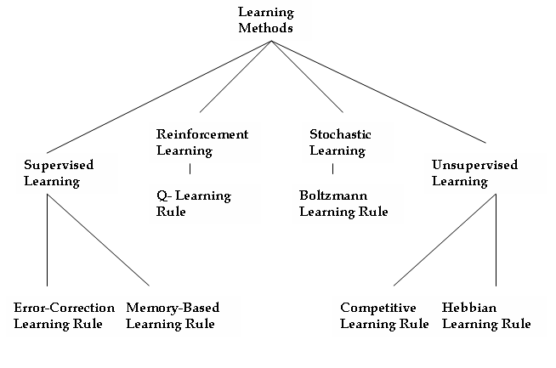

Slide 14
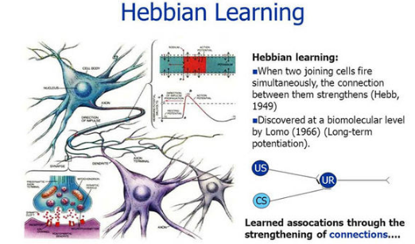
Hebbian Learning Rule
The Hebbian rule was the first learning rule. In 1949 Donald Hebb developed it as learning algorithm of the unsupervised neural network. We can use it to identify how to improve the weights of nodes of a network.
The Hebb learning rule assumes that – If two neighbor neurons activated and deactivated at the same time. Then the weight connecting these neurons should increase. For neurons operating in the opposite phase, the weight between them should decrease. If there is no signal correlation, the weight should not change.

Slide 15
Delta Learning Rule
Developed by Widrow and Hoff, the delta rule, is one of the most common learning rules. It depends on supervised learning.
This rule states that the modification in sympatric weight of a node is equal to the multiplication of error and the input.
Correlation Learning Rule
The correlation learning rule based on a similar principle as the Hebbian learning rule. It assumes that weights between responding neurons should be more positive, and weights between neurons with opposite reaction should be more negative.
Contrary to the Hebbian rule, the correlation rule is the supervised learning. Instead of an actual
Out Star Learning Rule
We use the Out Star Learning Rule when we assume that nodes or neurons in a network arranged in a layer. Here the weights connected to a certain node should be equal to the desired outputs for the neurons connected through those weights. The out start rule produces the desired response t for the layer of n nodes.

